Slide 1



HEART RATE SENSOR USING ESP-32 FOR STRESS DETECTION

Slide 2







Our Team
ALISHA JOY
DEEKSHITHA M
SNEHA K
VISHNU PRIYA S

Slide 3

Contents
01
Our Team
02
Need to consider mental health
03
Statistics
04
Requirements
05
Heart Rate Monitoring
06
Stress detection
07
Conclusion

Slide 4

Mental Health
01
Plays a vital role in our overall wellbeing.
Not having proper mental health education, hence no timely treatments provided.
02
To incorporate technology to spread awareness about mental wellbeing and its impact.
03
To spread smiles around the world.
04

Slide 5

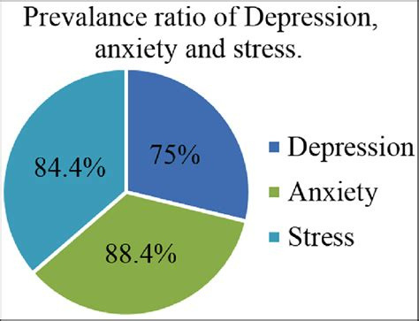
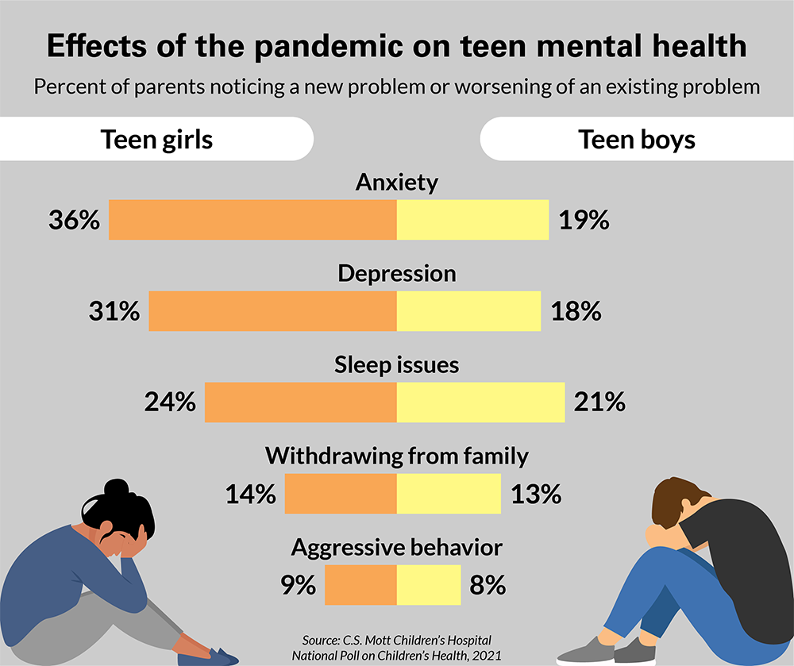
STATISTICS

Slide 6


IMPLEMENTATION

Slide 7




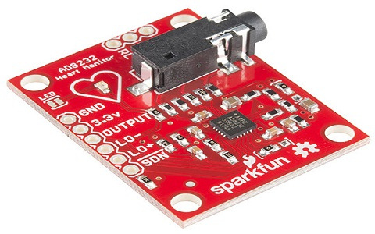
ESP-32
ARDUINO IDE SETUP
REQUIREMENTS
ECG KIT ELECTRODES
AD8232 SENSOR BOARD

Slide 8

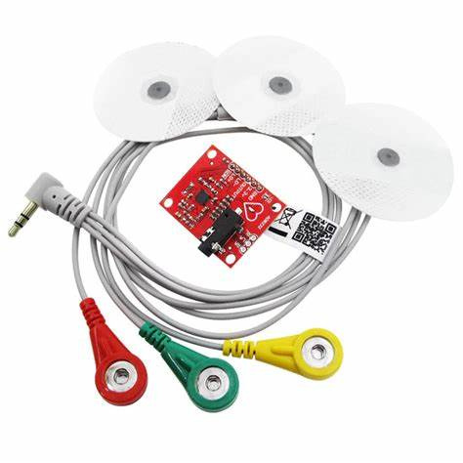
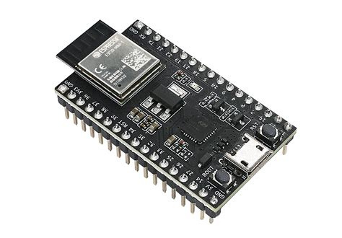
COMPONENTS
AD8232 BOARD
ESP-32
ECG LEARNERS KIT

Slide 9

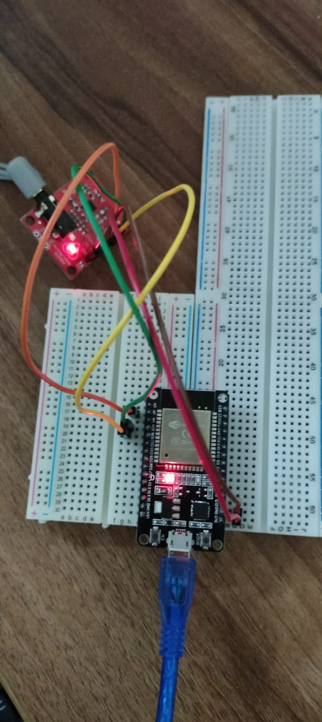
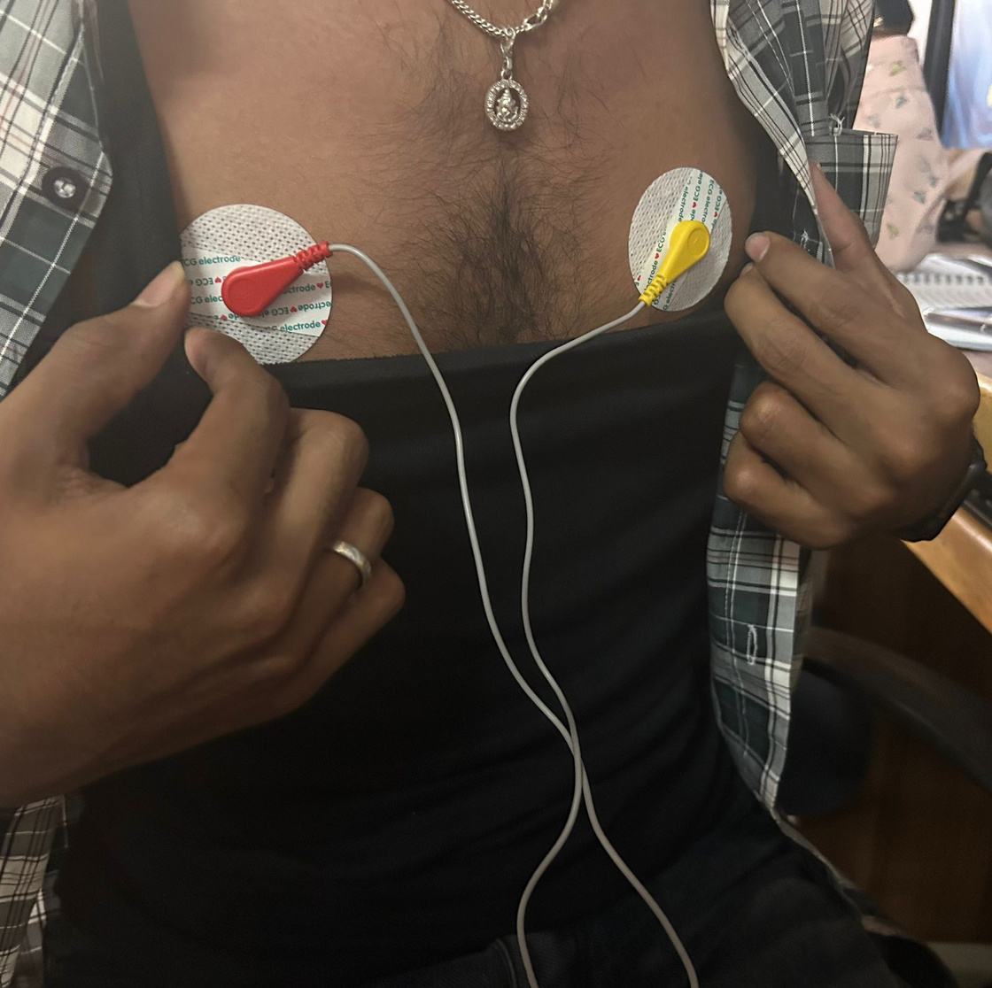
Connections

Slide 10
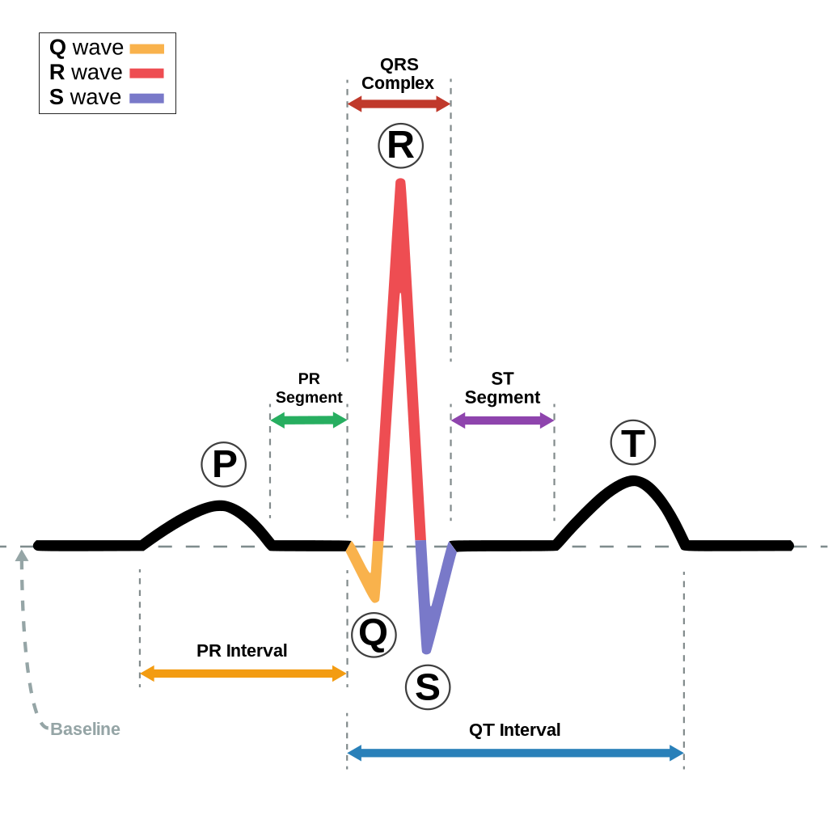

Slide 11
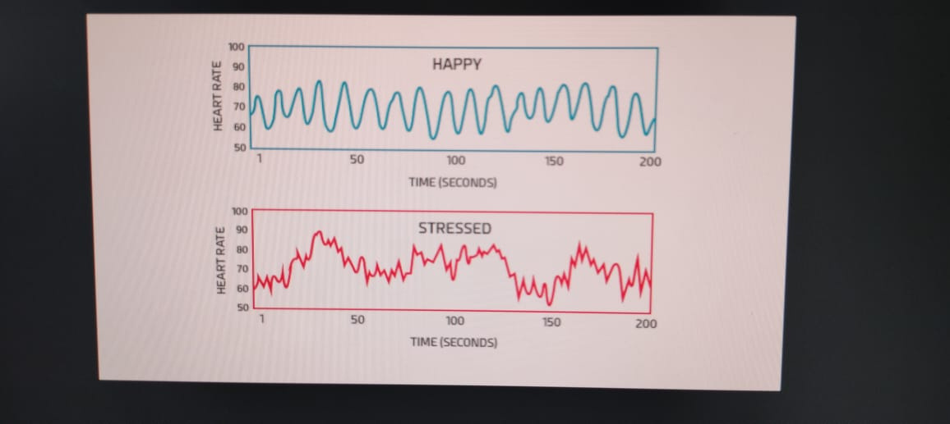

Slide 12

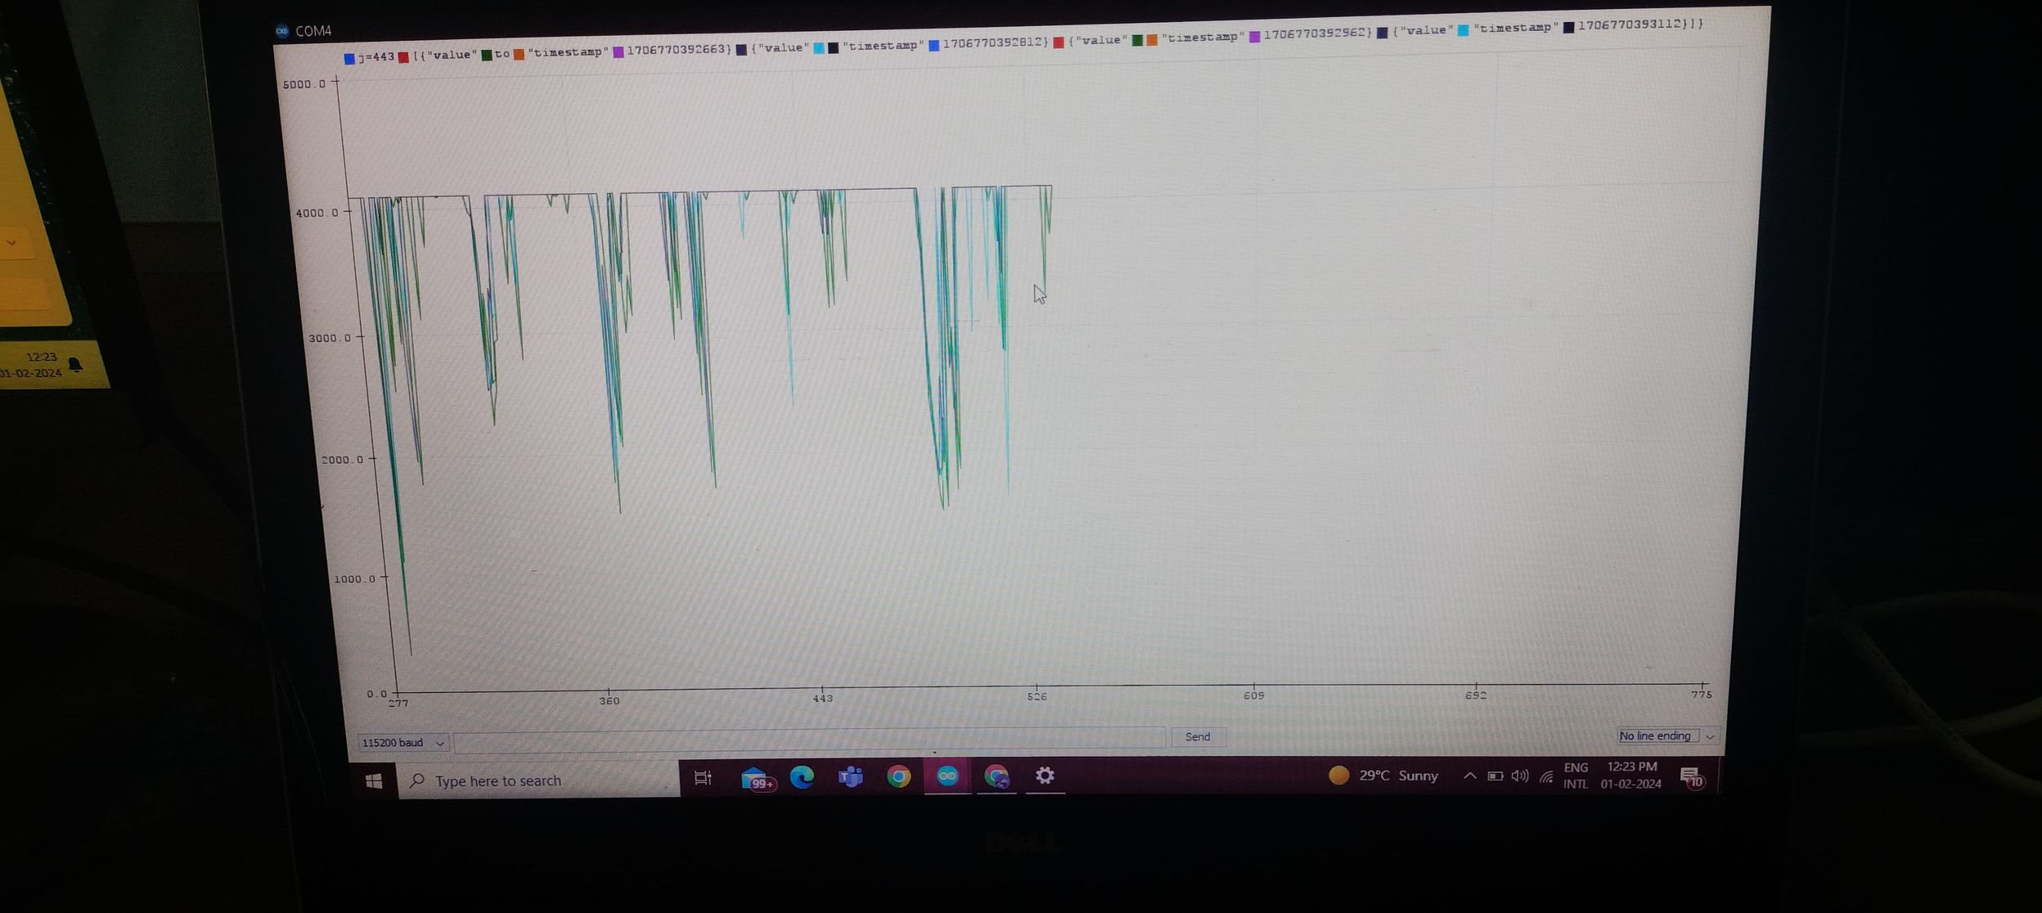
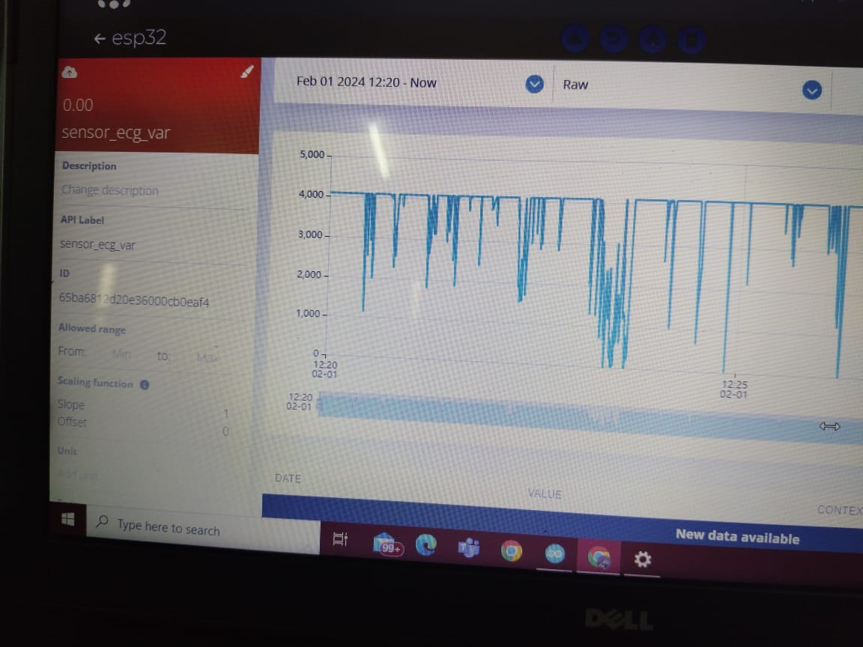
GRAPHICAL OUTPUTS
Graph obtained using arduino IDE
Graph obtained on ubidots

Slide 13
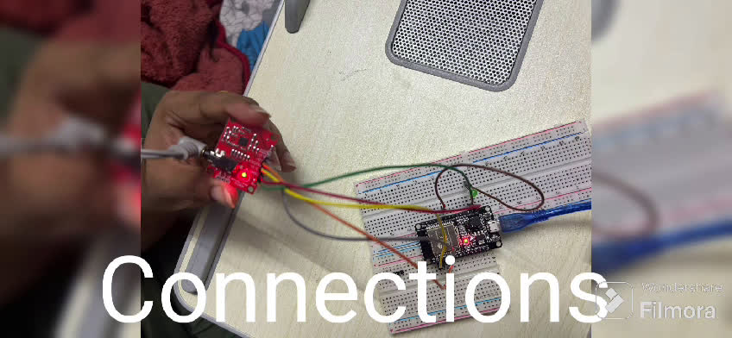

Slide 14

THANK YOU

